Slide 1
CS310 Operating Systems Lecture 35 : File System - 3
Ravi Mittal
IIT Goa

Slide 2
Acknowledgements !
Contents of this class presentation has been taken from various sources. Thanks are due to the original content creators:
Book: Modern Operating Systems by Andrew Tanenbaum and Herbert Bos,
Chapter 4
Book: Linux System Programming: talking directly to the kernel and C library, by Robert Love
Book: Linux – The Textbook, by Sarwar, Koretsky
Book: Advanced Programming in the Unix Environment, by W Richard Stevens and Stephen Rogo
Lecture Notes: IC221 Systems Programming,
https://www.usna.edu/Users/cs/wcbrown/courses/IC221/classes/L09/Class.html

Slide 3
Read the following:
Book: Modern Operating Systems, by Andrew Tanenbaum and Herbert Bos
Chapter 4
Book: Linux System Programming: talking directly to the kernel and C library, by Robert Love
Book: Linux – The Textbook, by Sarwar, Koretsky
Book: Advanced Programming in the Unix Environment, by W Richard Stevens and Stephen Rago

Slide 4
Today’s Class
File System – Introduction (previous class)
File System –Data Structures
File System - Name Space
Virtual File System
Basic File System APIs

Slide 5
Previous Classes

Slide 6
File System
Files are logical unit of information – Created by Processes
A Disk may contain thousands of files – usually independent of each other
Processes can read existing files and create new files
Files remain in existence not affected by process creation and termination
File must disappear only when the owner explicitly deletes it
File are managed by Operating system
File System deals with how files are
Structured
Named
Accessed
Used
Protected
Implemented, and
Managed
Adapted from: Tanenbaum, Modern Operating Systems

Slide 7
File Structure – Three Types
Byte
sequence
Record
sequence
Tree
Adapted from: Tanenbaum, Modern Operating Systems

Slide 8
Regular Files (Linux)
File reading or writing is done byte by byte
The file position increases
File position may be set manually
File position starts at zero
Writing a byte to the middle of a file overwrites over the previous byte
It is not possible to expand a file by writing into middle of it
Adapted from: Linux System Programming : Robert Love

Slide 9
Hierarchical organization of files using directories
Operating Systems Principles and Practice: Anderson and Dahlin

Slide 10
Directory is (not always) a tree
Sometimes it is convenient for a file to appear in two directories
Operating Systems Principles and Practice: Anderson and Dahlin

Slide 11
File System Data Structures (Unix)

Slide 12
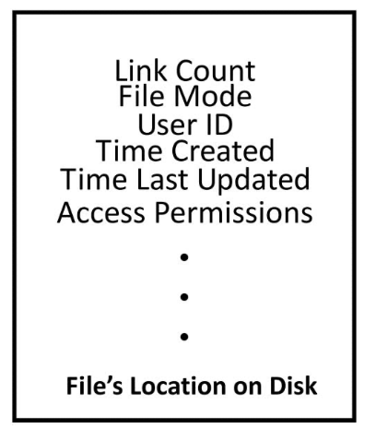
Contents of inode
Adapted from: Linux: The Textbook by Sarwar and koretsky

Slide 13
Inode diagram
inode
File info
Direct blocks
Indirect blocks
Double
Indirect
Blocks

Slide 14
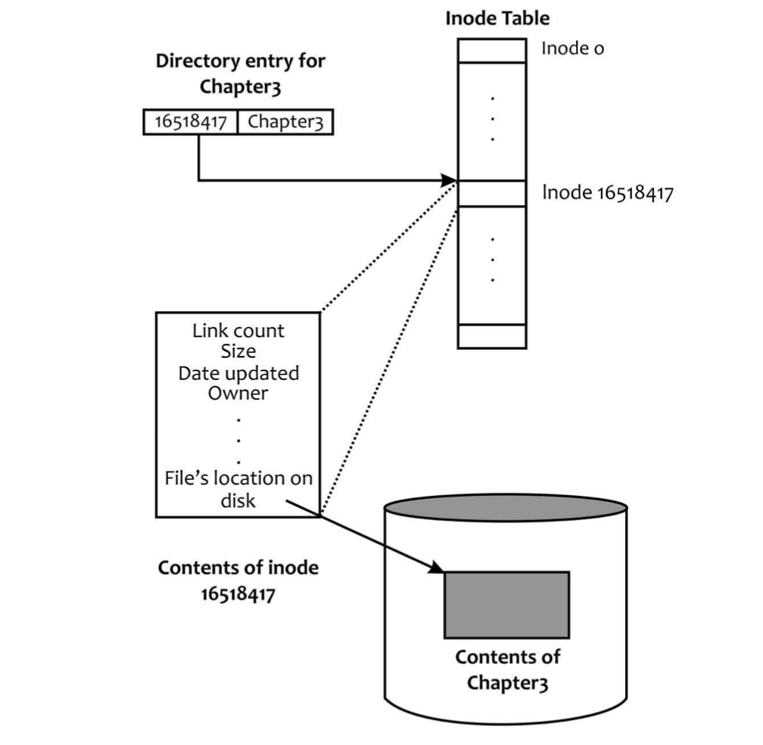
Directory Entry, inode, and file contents
Adapted from: Linux: The Textbook by Sarwar and koretsky

Slide 15
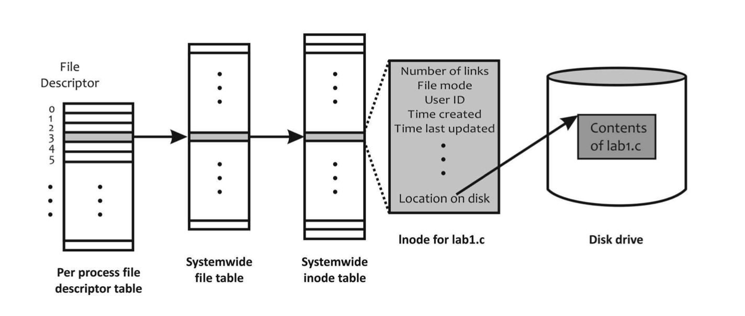
File descriptor, file table, inode, disk
vnode table (Unix)
Adapted from: Linux: The Textbook by Sarwar and koretsky

Slide 16
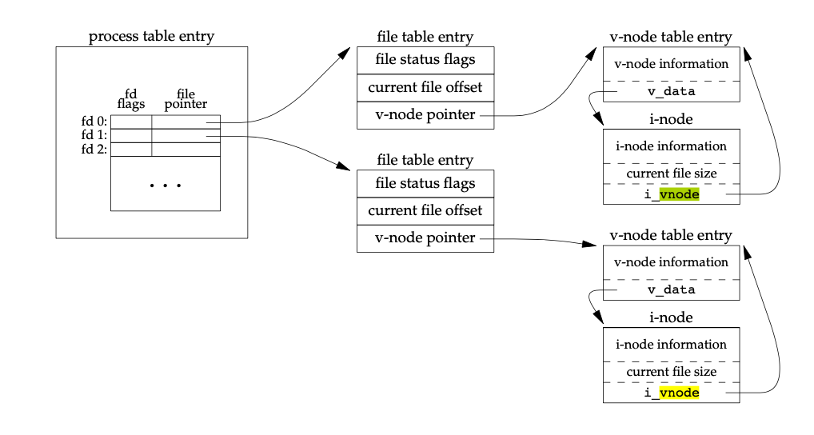
Kernel Data Structures for open files (Unix)
For a single process
Two files are open
Book: APUE – Richard Stevens and Stephen Rago

Slide 17
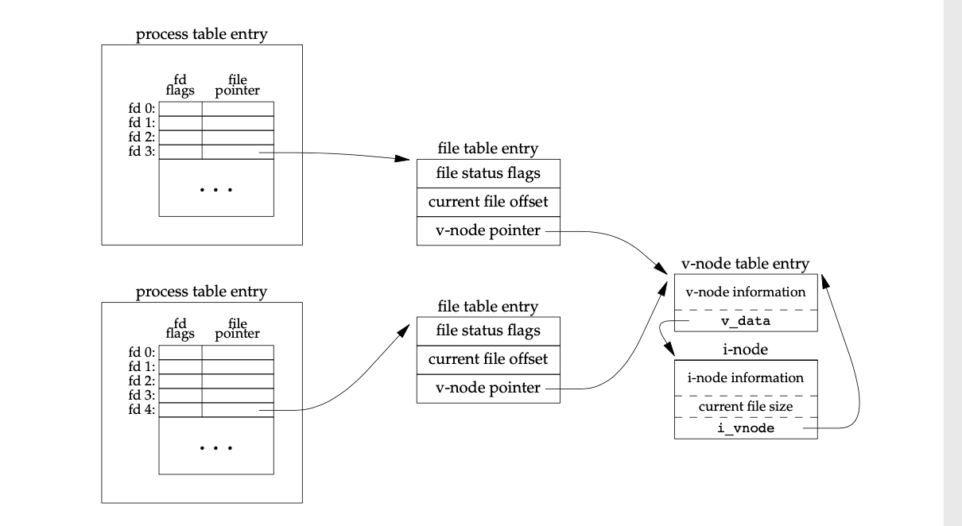
Two processes using the same opened file
Book: APUE – Richard Stevens and Stephen Rago

Slide 18
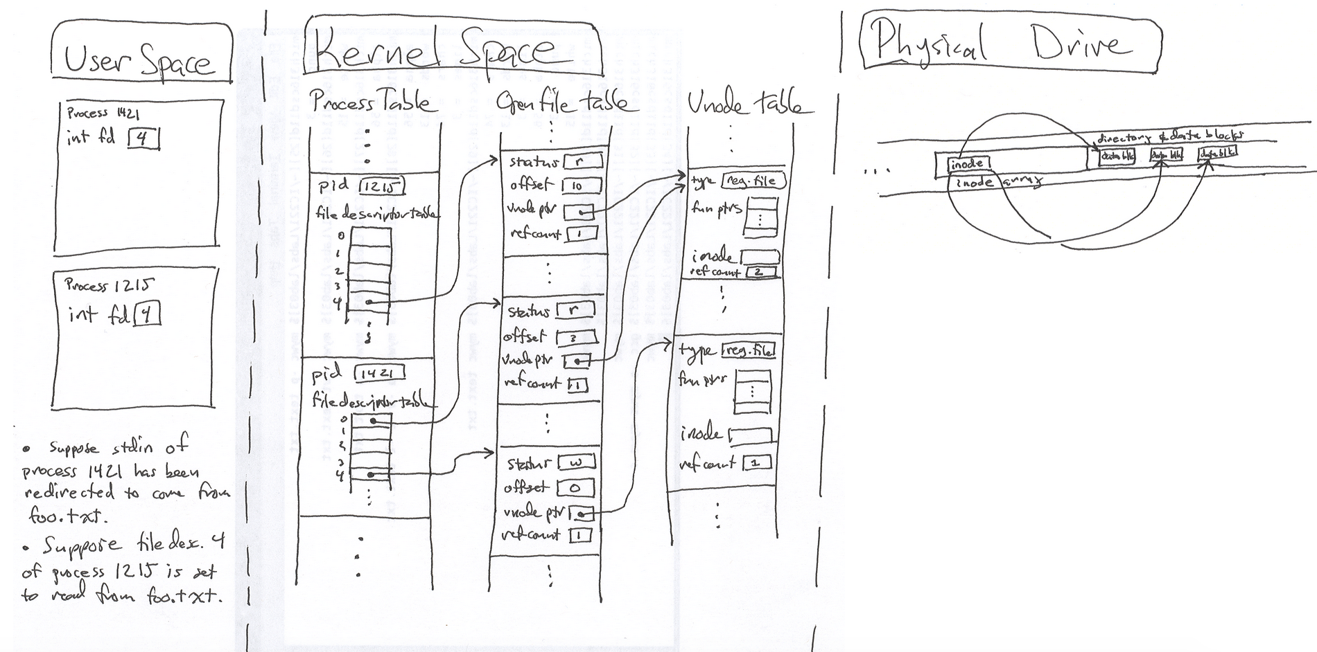
Big Picture
https://www.usna.edu/Users/cs/wcbrown/courses/IC221/classes/L09/Class.html

Slide 19
File descriptor
Kernel and the user process refer to each open connection by a number (type int) called a file descriptor
The kernel uses file descriptors to perform file operations
Example: file read
The kernel uses a file descriptor to index the per-process file descriptor table
Obtains a pointer to the systemwide file table
File descriptor Table (per process):
It resides in Process Table entry (PCB)
PCB contains all file descriptors currently in use by a process
Each file descriptor points to a file table entry
Book: APUE – Richard Stevens and Stephen Rago

Slide 20
System Open File Table
The system needs to keep track of each connection to a file
Since the same file may have many open connections, this connection is truly distinct from the concept of a file
Distinct processes may even share a connection
eg. two processes wanted to write to the same log file, each adding new data to the end of the file)
The connection information cannot be kept inside the process table
Kernel keeps a data structure called the system open-file table which has an entry for each connection
Entry contains
Connection Status: read or write
Current offset in the file
A pointer to vnode entry for the file
Vnode is data structure representing the file
Linux: vnode → generic inode
Book: APUE – Richard Stevens and Stephen Rago

Slide 21
Vnode table
Each open file has a vnode structure
Vnode contains
Information about type of the file
Pointers to functions that operate of file
Copy of the inode for the file
Physical information about the file
This information (about inode) is read from the disk when the file is opened
Reference Count: gives the number of hard links
A file can’t be removed from the file system unless all of those references are removed
Book: APUE – Richard Stevens and Stephen Rago

Slide 22
Physical Device: inodes etc
The inode contains the owner of the file, the size of the file, pointers to where the actual data blocks for the file are located on disk
A file may be broken up into many data blocks, which may be widely distributed across the physical drive
The inode for a file contains the locations of each of the data blocks comprising the file
Book: APUE – Richard Stevens and Stephen Rago

Slide 23
Special Files

Slide 24
File Types
Regular Files (most common)
Text
Binary
Directories
A file that contains the names and locations of other files
Character Special and Block Special Files
Terminals (character special) and disks (block special)
FIFO (named pipe)
A file type used for inter-process communication
Socket
A file type used for network communication between processes
Adapted from: Tanenbaum, Modern Operating Systems

Slide 25
Special Files
Special files are kernel objects that are represented as files
Linux supports four types of files
block device files,
character device files,
named pipes, and
Unix domain sockets
Special files are a way to let certain abstractions fit into the filesystem
Everything-is-a-file paradigm
Linux provides a system call to create a special file

Slide 26
Device Files
I/O devices are treated as special files called device files
Hence, device access (in Unix/Linux systems) is performed via device files
Act and look like normal files residing on the file system
The same system calls used to interact with regular files on disk can be used to directly interact with I/O devices
Device files may be opened, read from, and written to
This allows users to access and manipulate devices on the system
Each type of device has its own special device file
Two types
Character Devices
Block Devices

Slide 27
Character Device - Files
Character devices are accessed via a special file called a character device file (node)
A character device is accessed as a linear queue of bytes
The device driver places bytes onto the queue, one by one
User space reads the bytes in the order that they were placed on the queue
Character devices are accessed via character device files
Character devices provide access to data only as a stream, generally of characters (bytes)
Example: Keyboard, mice, printers etc

Slide 28
Block Device - Files
A block device, in contrast, is accessed as an array of bytes
The device driver maps the bytes over a seekable device
User space is free to access any valid bytes in the array, in any order
Read byte 12, byte 7, byte 15 etc
Block devices are generally storage devices
Hard disks, CD-ROM drives, Flash Memory
They are accessed via block device files
Generally mounted as a filesystem

Slide 29
File System Name Space

Slide 30
Volume
A volume is a collection of physical storage resources that form a logical storage device
Each instance of a file system manages files and directories for a volume
A volume is an abstraction that corresponds to a logical disk

Slide 31
File System and namespaces
Some operating systems separate different disks and drives into separate namespaces
a file on a floppy disk might be accessible via the pathname A:\plank.jpg
the hard drive is located at C:\
DOS and Windows, which break the file namespace up into drive letters
This breaks the namespace up among device and partition boundaries
Linux (Unix) provides a global and unified namespace of files and directories
In Unix, that same file on a floppy might be accessible via the pathname /media/floppy/plank.jpg
Alongside files from other media

Slide 32
Mounting and Unmounting
A filesystem is a collection of files and directories in a formal and valid hierarchy
Filesystems may be individually added to and removed from the global namespace of files and directories
These operations are called mounting and unmounting
Each filesystem is mounted to a specific location in the namespace, known as a mount point
The root directory of the (added) filesystem is then accessible at this mount point
For example, a CD might be mounted at /media/cdrom, making the root of the filesystem on the CD accessible at /media/cdrom

Slide 33
Mount (repeat)
Mount allows multiple file systems on multiple volumes to form a single logical hierarchy
Mounting a volume on an existing file system creates a mapping from some path in the existing file system to the root directory of the mounted volume’s file system
Mounting enables all mounted filesystems to appear as entries in a single tree

Slide 34
USB Volume

Slide 35
Mapping from some path in existing file system to the root directory of the mounted file system
Alice can access the vacation.mov movie using the path /Volumes/usb1/Movies/vacation.mov
Bob can access the movie using the path /media/disk-1/Movies/vacation.mov

Slide 36
Virtual File System (Linux/Unix)

Slide 37
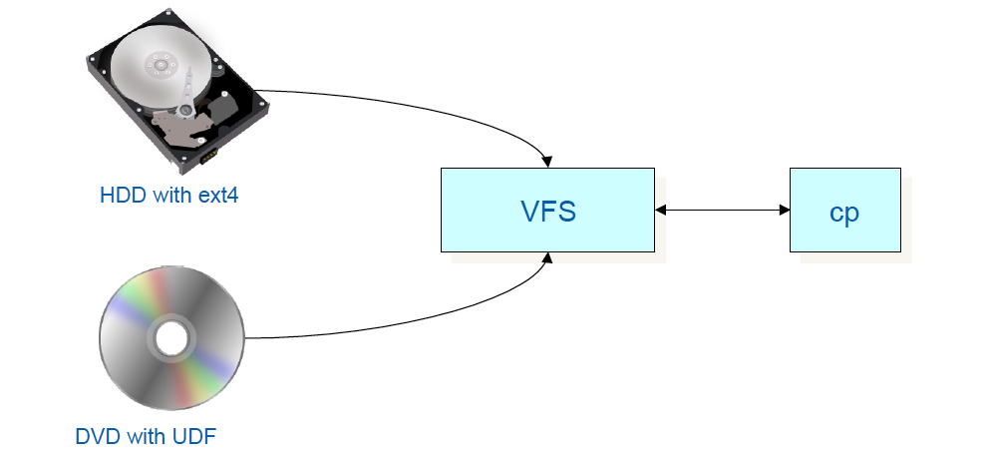
Virtual File System (Unix/Linux)
The Virtual File System (VFS) implements a generic file system interface between the actual file system implementation (in kernel) and accessing applications
Applications can access different file systems on different media via a homogeneous set of UNIX system calls
Adapted from: Linux System Programming : Robert Love

Slide 38
Virtual File System
VFS is a glue that enables syscalls such as open(), read(), and write()to work regardless of the filesystem or underlying physical medium
System calls work between these different filesystems and media
In older operating systems, such as DOS, this would never have worked
Generic Interface
Kernel implements abstraction layer around low-level interfaces
Linux to support different filesystems, even if they differ in supported features or behavior
FAT, Windows NTFS, Linux and Unix file systems
Adapted from: Linux System Programming : Robert Love

Slide 39
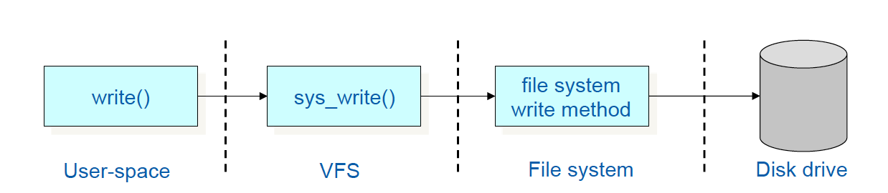
Virtual File System
To the user, each file system looks the same
Example: write (fd, &buf, len);
Write len bytes in file with descriptor f from buffer buf
It is translated into a system call sys_write() which determines the actual file writing method for the filesystem that holds file corresponding to fd
The generic write system call is then invokes the method that is part of the filesystem implementation
Adapted from: Linux System Programming : Robert Love

Slide 40
Basic File System APIs

Slide 41
File System API – file creation
Creating files
create() creates
a new file with some metadata, and
a name for that file in a directory
link() creates a hard link
a new name for the same underlying file
unlink() removes a name for a file from its directory
If a file has multiple names or links, unlink() only removes the specified name, leaving the file accessible via other names
If the specified name is the last (or only) link to a file, then unlink() also deletes the underlying file and frees its resources
mkdir() and rmdir() create and delete directories

Slide 42
File System API – Open and Close
Open()
To get a file descriptor it can use to refer to the opened file
Path parsing and permission checking can be done just when a file is opened
Not repeated on each read or write
The OS creates a data structure that stores information about the file: file id, read/write/exec, pointer to the processes current position in the file
The file descriptor can thus be thought of as a reference to the operating system’s per-open-file data structure that the operating system will use for managing the process’s access to the file
Close()
Releases the open file record in the operating system

Slide 43
File System API – File Access
While a file is open, an application can access the file’s data in two ways
read()
Write()
Call to read and write starts from files current position
Seek()
Supports random access within a file
Seek() call changes a process’s current position for a specified open file
Other APIs
munmap()
fsync()

Slide 44
Lecture Summary
In file system (Unix / Linux) the following data structures are used
File descriptor
File Table entry (Process Control Block)
Open File Table
Vnode or generic inode table
Inode
Devices are accessed with special files: Character special and block special files
File Name Space
Mounting and Unmounting
Virtual File System (Linux / Unix)
File APIs

